Slide 1





勤 学 / 修 德 / 明 辨 / 笃 实
Project 10:
Ad Position Investigation
Date：June 12 ，2023
Members：Ruofan Hu,Qi wang,Haolun Zheng,Weijing Guo,Yanwei Xu

Slide 2




CONTENTS
Background
Motivation
Proposed Methodology
Experiment
Results

Slide 3

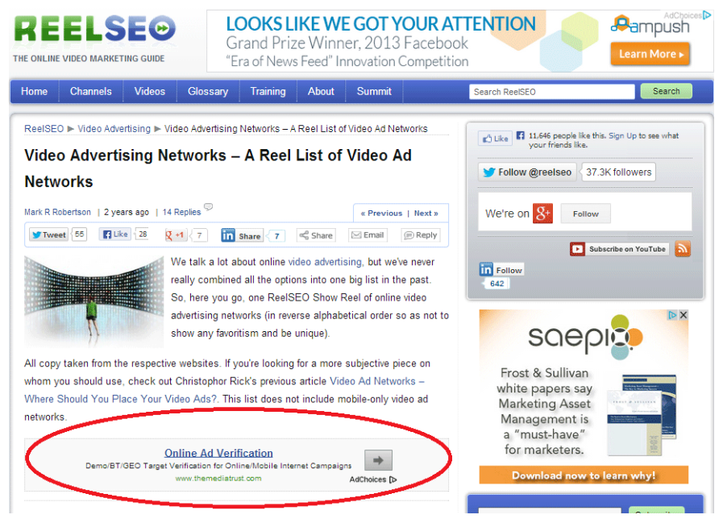
Background
Motivation
Methodology
Results
What is “ad position”?
Ad position is the position of your ad on a search results page or content-based webpage. It's determined by how your ad ranks against competing ads. Rank is determined by many factors, including:
The amount you bid for your keyword.
Your ad's relevance.
Your ad's performance, or click-through rate (CTR), on webpages.

Slide 4

Background
Motivation
Methodology
Results
monetize a website
display advertising
affiliate marketing
product sales
make more money

Slide 5
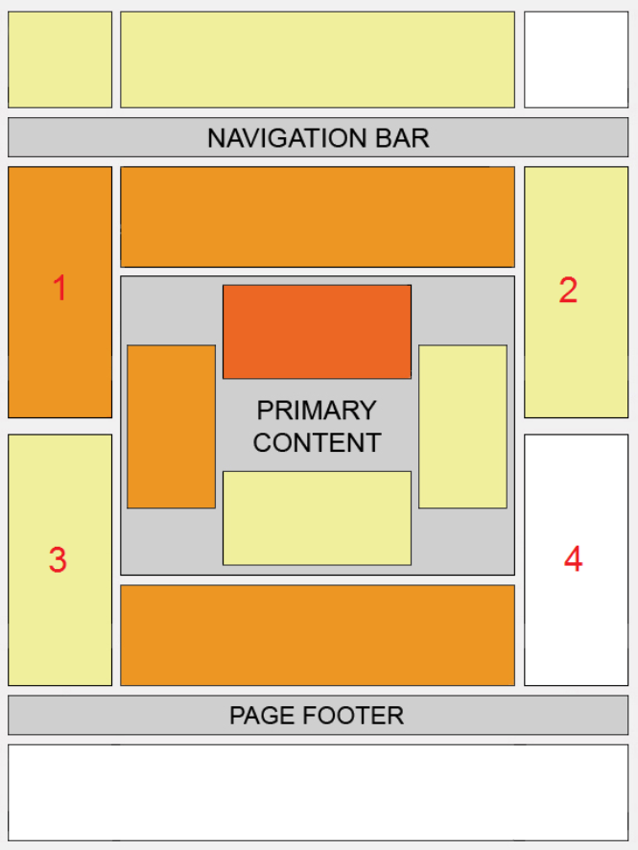
Background
Motivation
Methodology
Results
Not all positions are created equal！
（the most basic illustration of how we tend to consume the content on web pages, with darker sections illustrating sections that get more attention.）

Slide 6
Background
Motivation
Methodology
Results
place your ad units
above your primary content
to the left of your primary content
within your primary content.
（the illustration of where visitors‘ eyes tend to focus and which parts of the page are most likely to be overlooked）

Slide 7
CONTENT
Background
Motivation
Proposed Methodology
Experiment
Results

Slide 8

Background
Motivation
Methodology
Results
What is the goal or purpose of this study
Not all website layouts are created equal
optimize your site setup and immediately boost earnings
maximize revenue without annoying visitors
monetize your traffic primarily

Slide 9
CONTENT
Background
Motivation
Proposed Methodology
Experiment
Results

Slide 10
Background
Motivation
Methodology
Results
Proposed Methodology
Relative position handling
web crawler
obtain 2000+ URLs
Image processing
Ad detection and treatment

Slide 11
Background
Motivation
Methodology
Results
Data collection
To obtain the 2000 URLs, we used a web crawler, by searching for keywords and extracting their pages, a key part of which was the use of page flips

Slide 12
Background
Motivation
Methodology
Results
Obtain 2000+ URLs
challenge :
used the requests library to make requests and then crawl
the crawled down page code did not have those little ads next to it
solution :
these ads were rendered later in post with JavaScript resulting in
used the selenium automation library to simulate our behaviour towards browsing

Slide 13
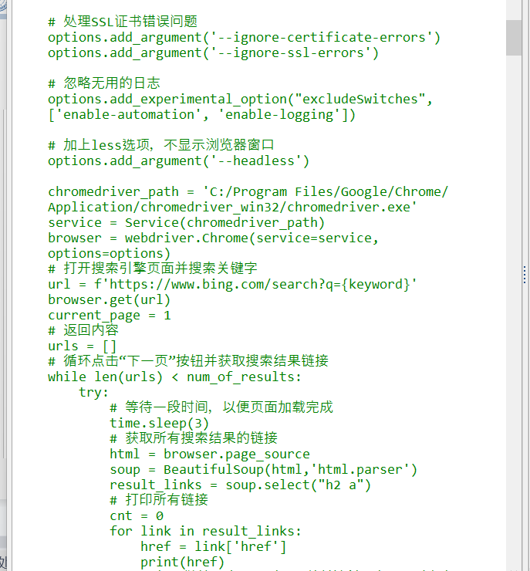
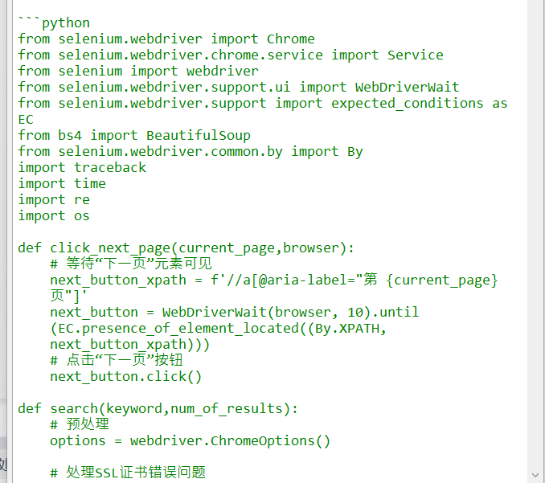
Background
Motivation
Methodology
Results
Coding

Slide 14
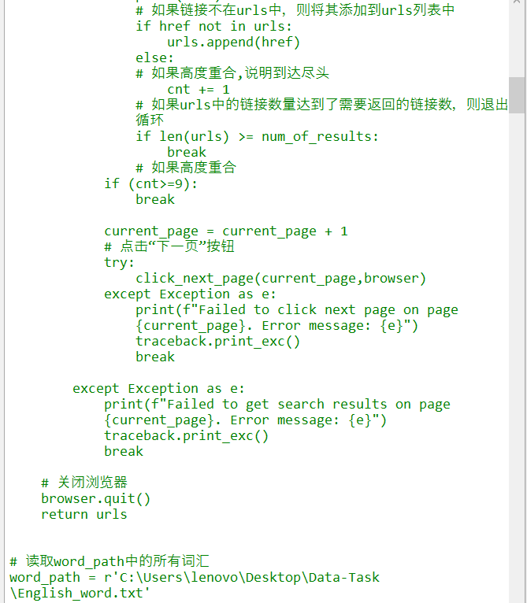
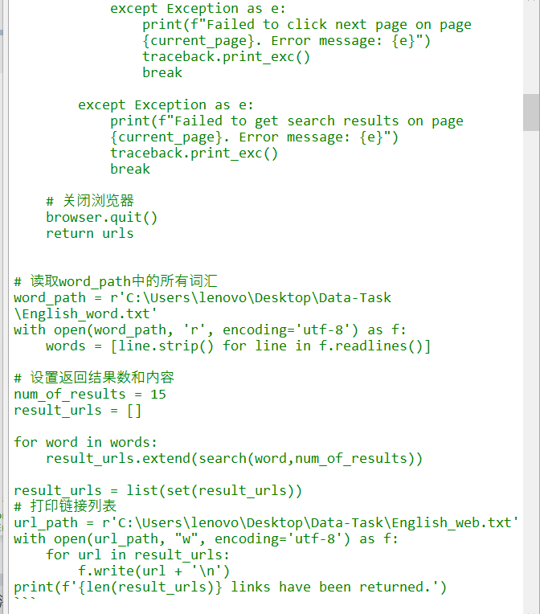
Background
Motivation
Methodology
Results

Slide 15
Background
Motivation
Methodology
Results
Image processing
download directly to the local area
url form
the src of the images
decode and synthesise the base64 code
base64 direct rendering
skip them
(not too many)
the base64 code of some images was not complete

Slide 16
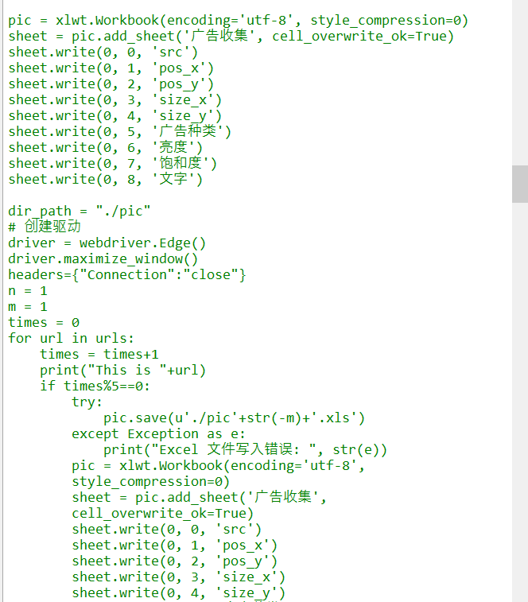
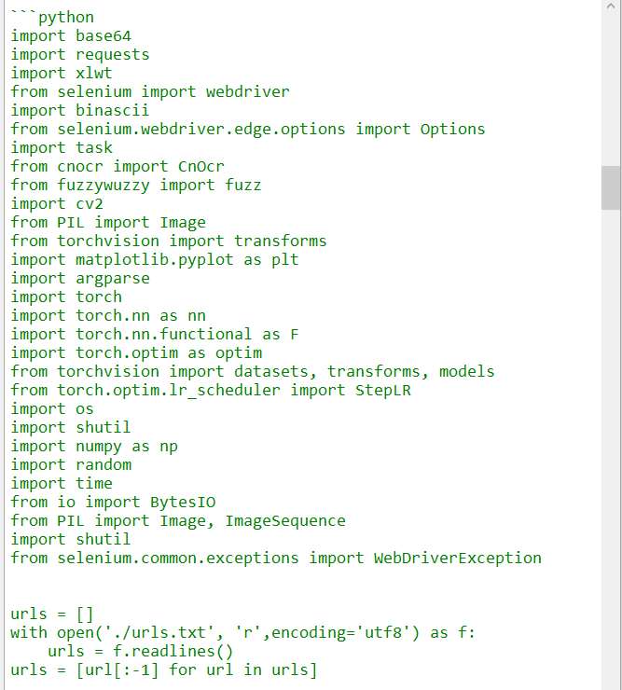
Background
Motivation
Methodology
Results
Coding

Slide 17
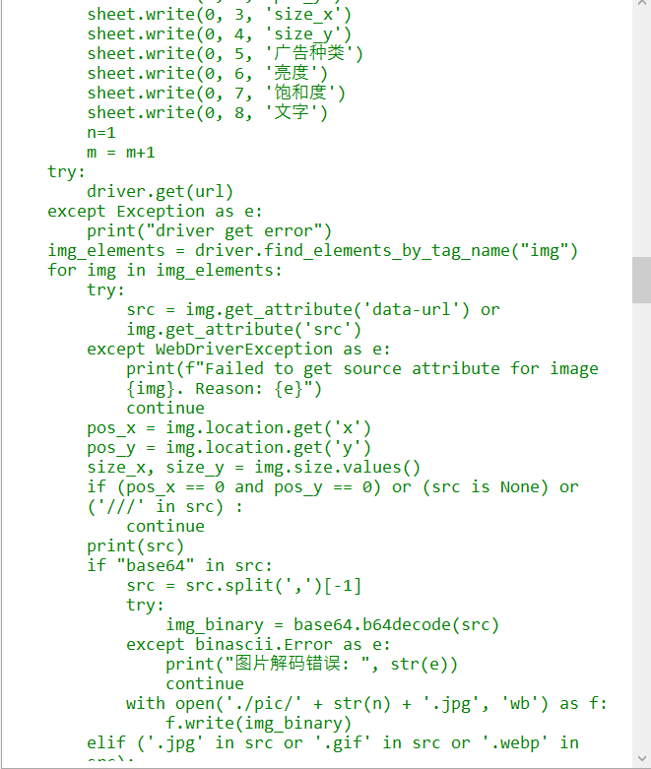
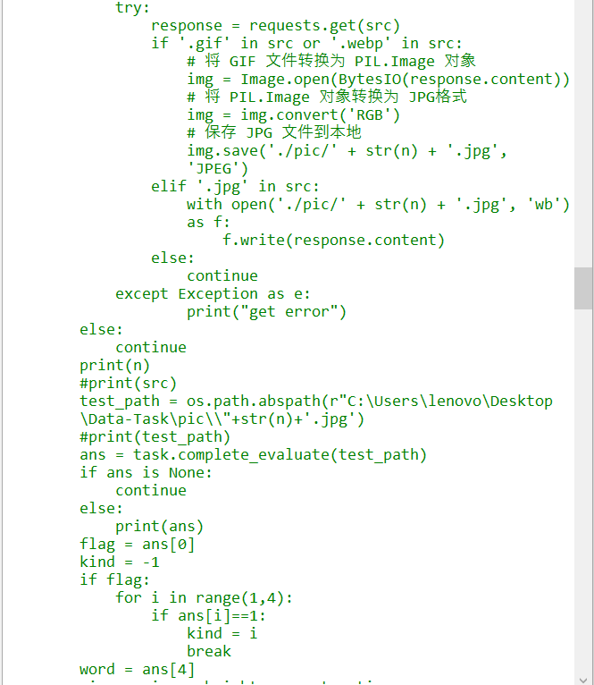
Background
Motivation
Methodology
Results

Slide 18
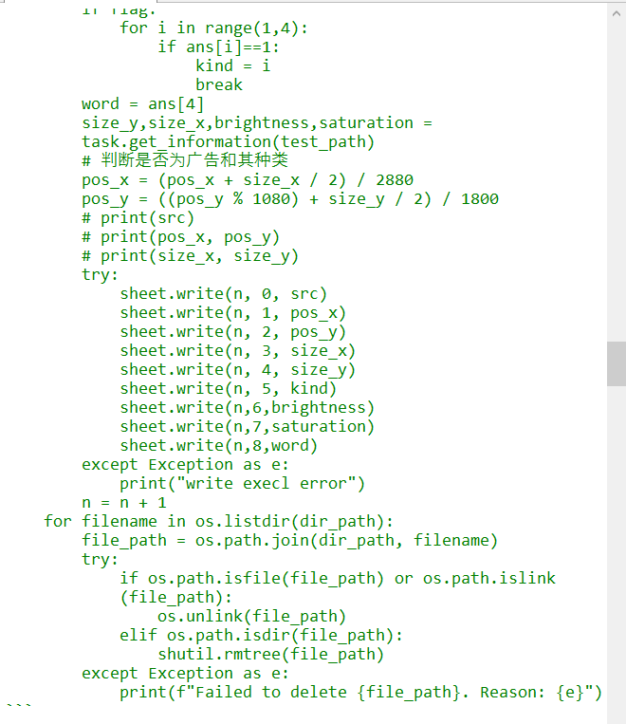
Background
Motivation
Methodology
Results

Slide 19
Background
Motivation
Methodology
Results
Relative position handling
relevant api interface of selenium
absolute coordinates of the image (x,y)
problem :
the coordinates of (0,0),which is certainly impossible
these pictures are not directly on the surface of the browser

Slide 20
Background
Motivation
Methodology
Results
Ad detection and treatment
text extraction tools
model detection tools
used Cnocr to match the text information in the advert with the common information in the advert.
used the dataset provided by the teaching assistant to train a CNN-based dataset

Slide 21
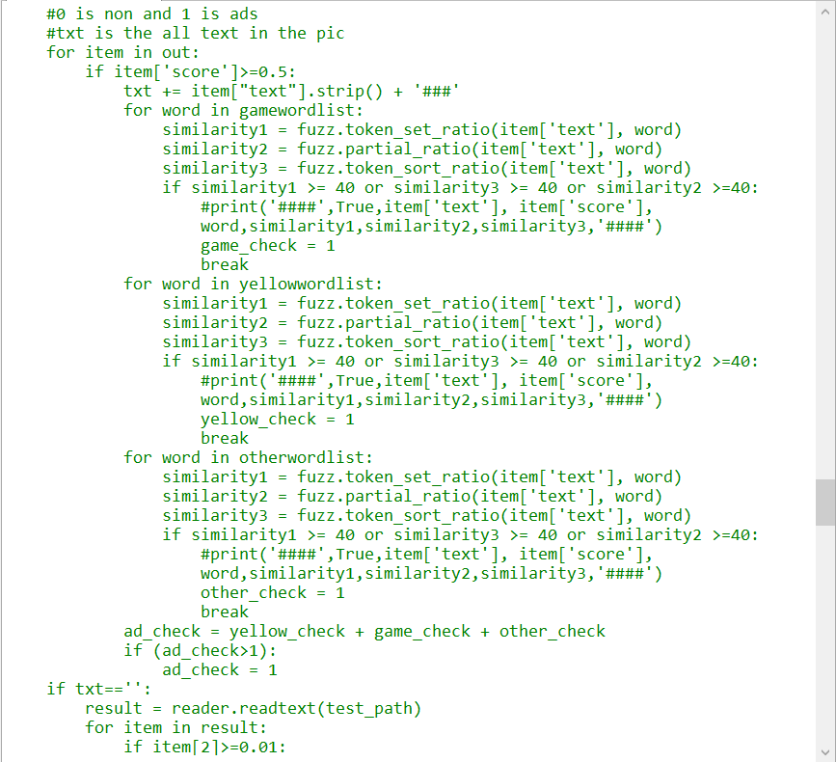
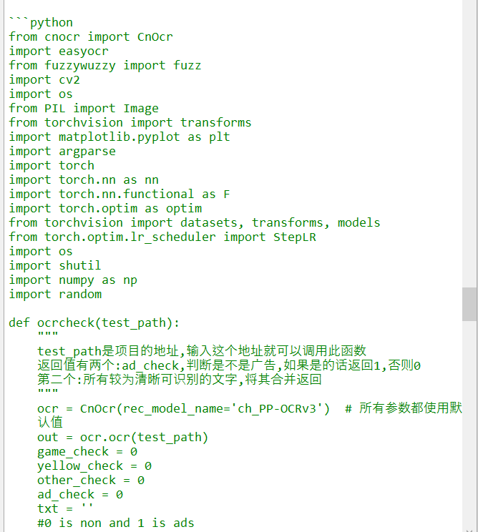
Background
Motivation
Methodology
Results
Coding

Slide 22
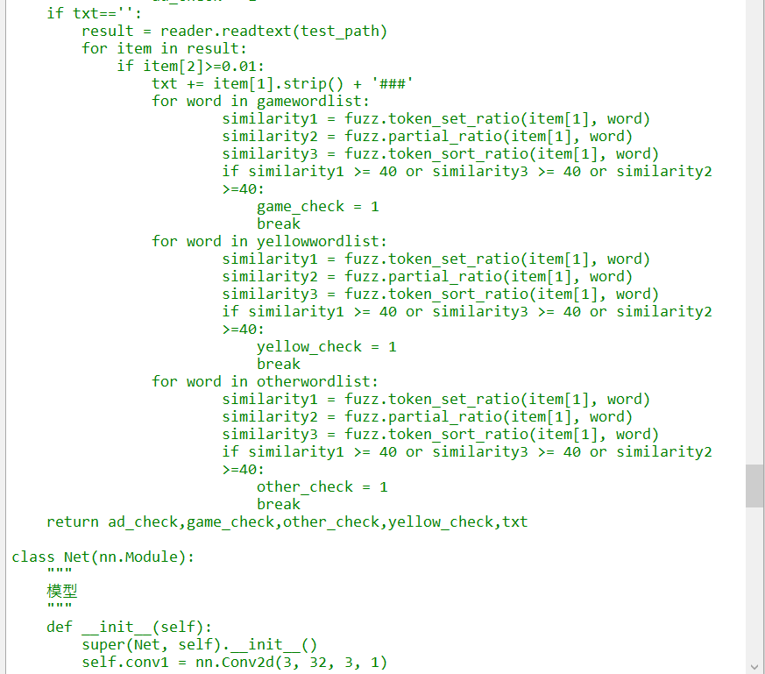
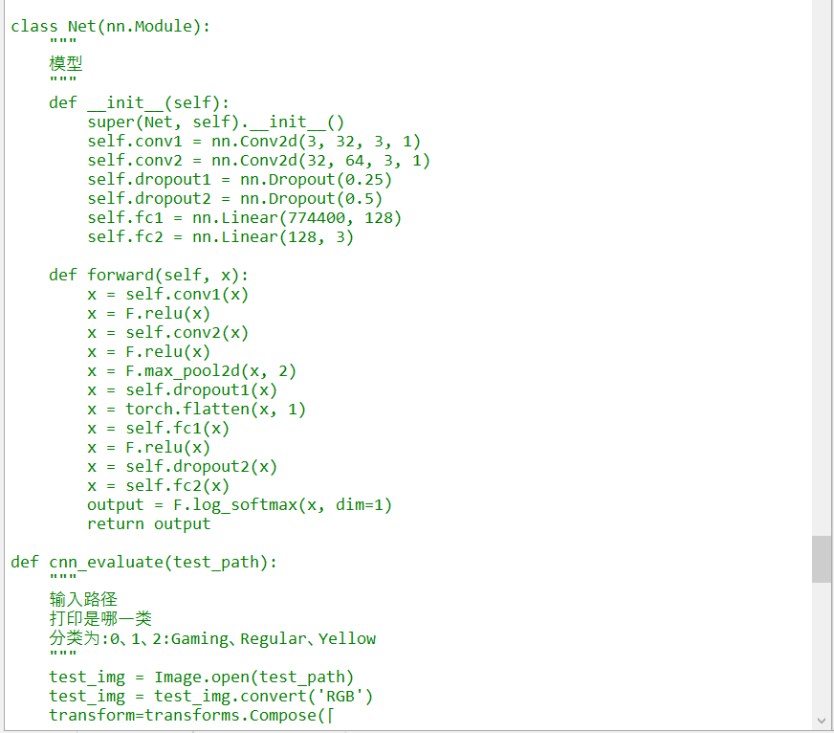
Background
Motivation
Methodology
Results

Slide 23
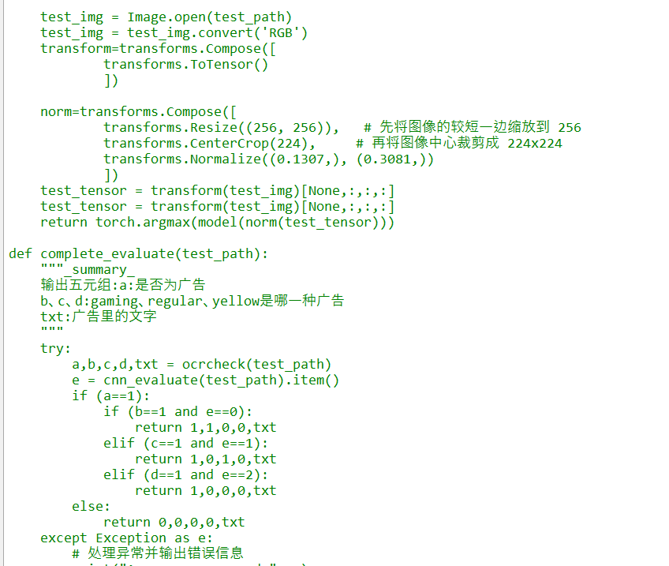
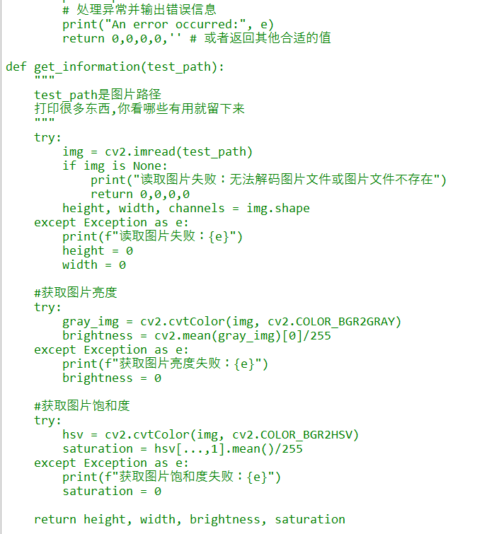
Background
Motivation
Methodology
Results

Slide 24
CONTENT
Background
Motivation
Proposed Methodology
Experiment
Results

Slide 25
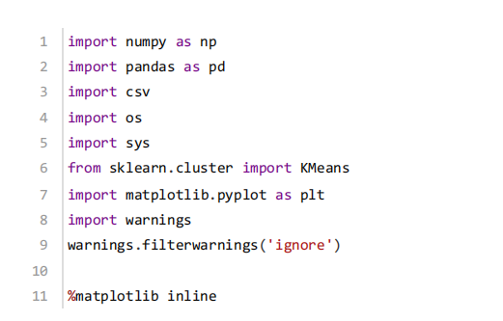
Background
Motivation
Methodology
Results
Data Analysis

Slide 26
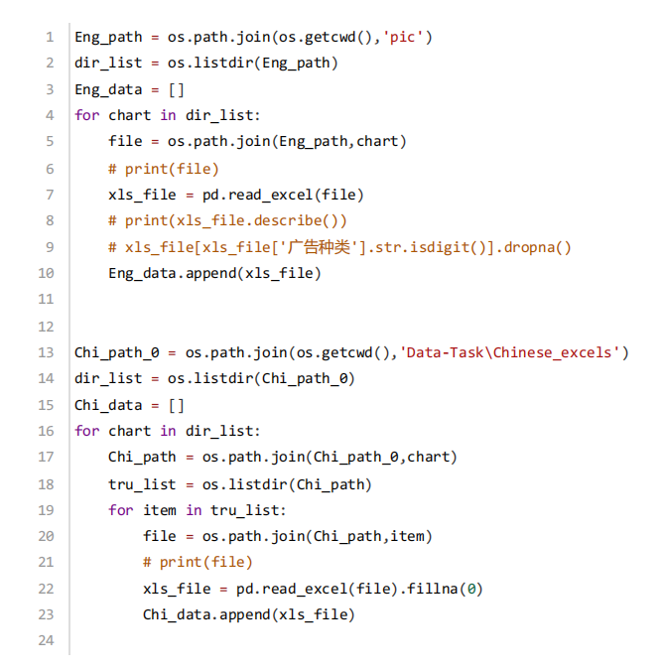
Background
Motivation
Methodology
Results
Data Reading
Use the csv module to read tables and construct separate tables for English and Chinese website information:

Slide 27
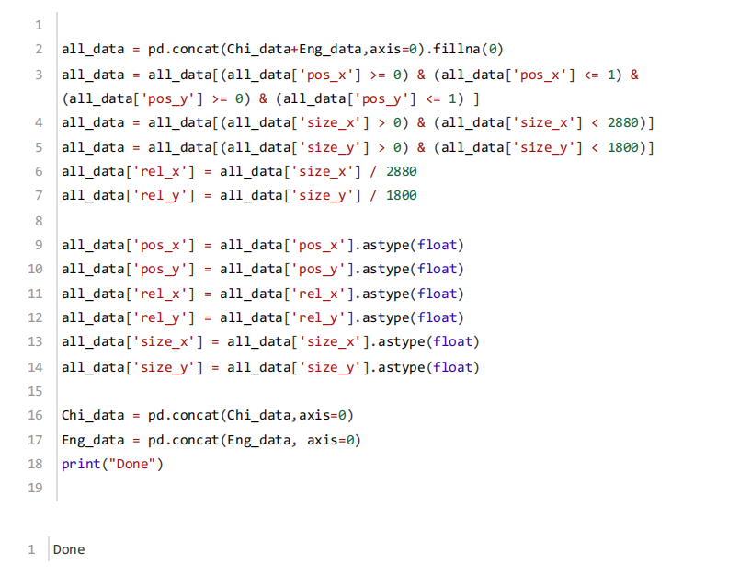
Background
Motivation
Methodology
Results
Data Reading
Combine the two tables and perform data cleaning:
Remove the incorrect data collected (relative size >1,<0)
Calculate the relative size of the images (rel_x,rel_y)

Slide 28
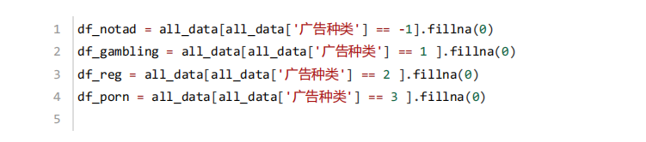
Background
Motivation
Methodology
Results
Allocation map
Tables for extracting different types of images, depending on the type of image:
-1 :Non-advertising
1 :Gambling advertisements
2 :Regular advertisements
3 :Pornographic advertisements

Slide 29
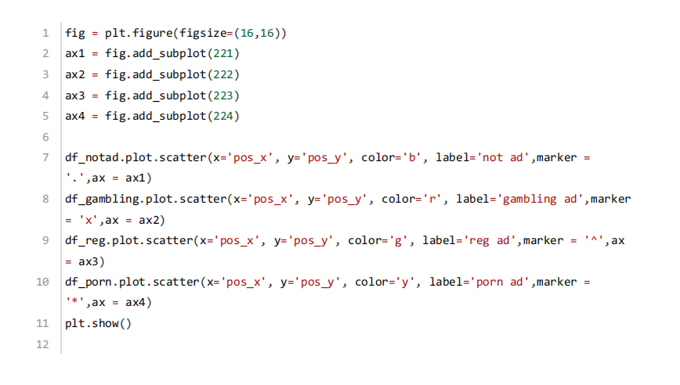
Background
Motivation
Methodology
Results
Allocation map
Separate scatter plots of their relative position distribution in the normalised scenario:

Slide 30
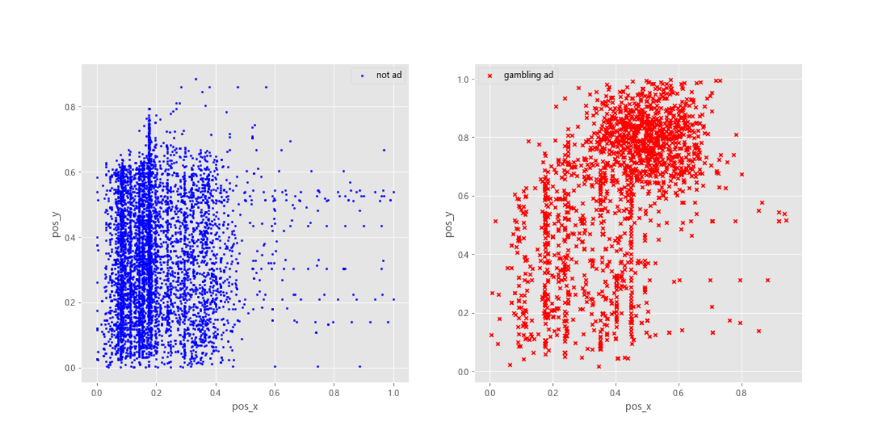
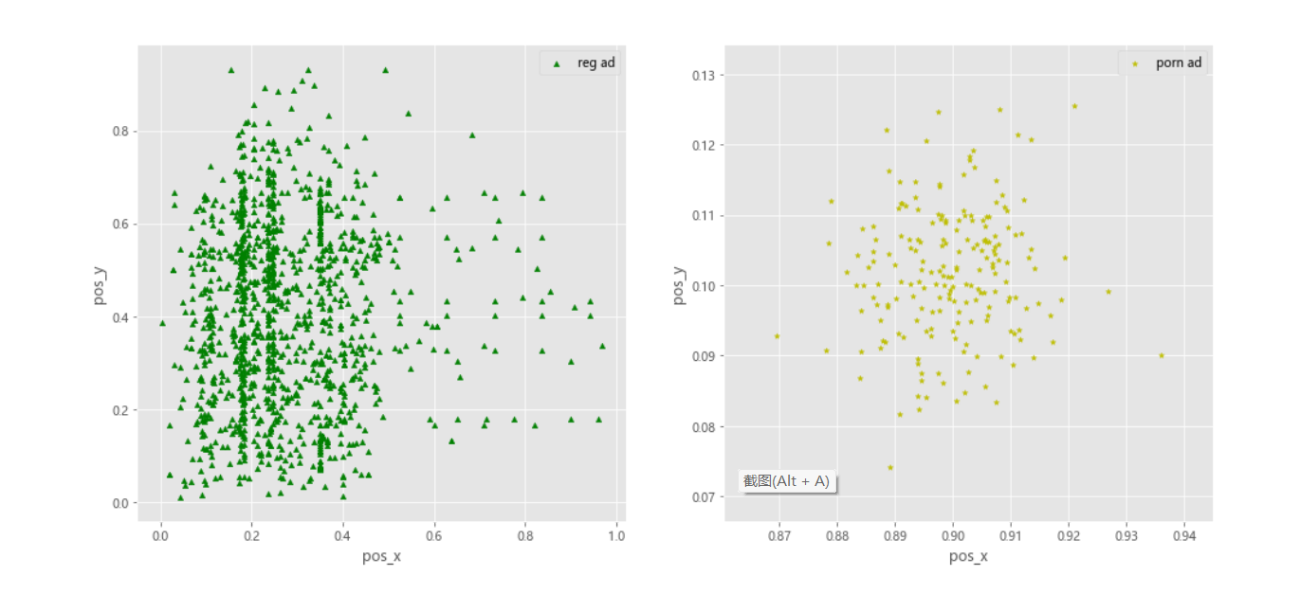
Background
Motivation
Methodology
Results
Allocation map

Slide 31
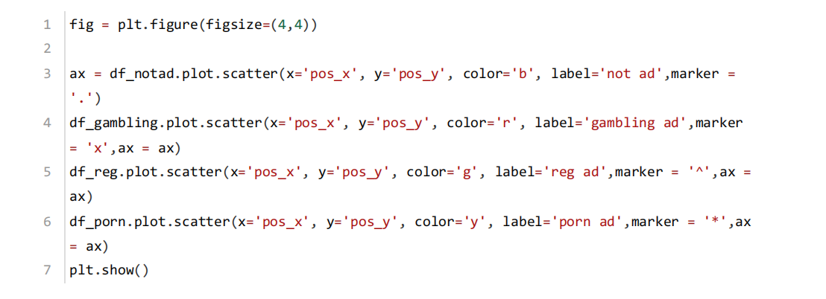
Background
Motivation
Methodology
Results
Allocation map
Put the four charts in the same chart:

Slide 32
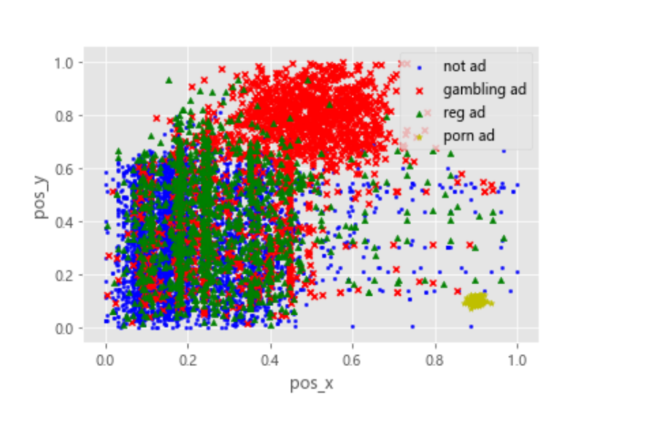
Background
Motivation
Methodology
Results
Allocation map

Slide 33
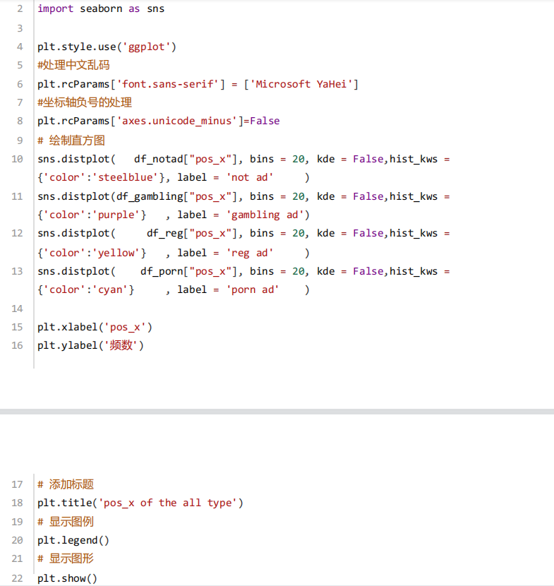
Background
Motivation
Methodology
Results
Allocation map
Histogram of the distribution of the four types of images on the x-axis
Histogram of the distribution of the four types of images on the y-axis
Histogram of the width distribution of the four types of images
Histogram of the distribution of the lengths of the four types of images

Slide 34
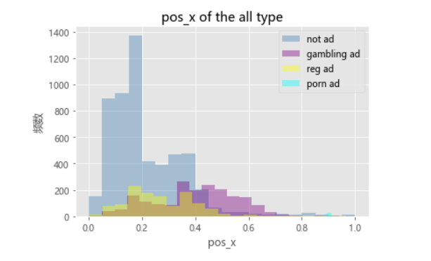
Background
Motivation
Methodology
Results
Allocation map
Histogram of the distribution of the four types of images on the x-axis

Slide 35
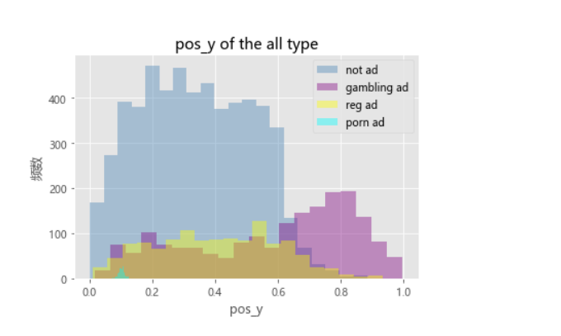
Background
Motivation
Methodology
Results
Allocation map
Histogram of the distribution of the four types of images on the y-axis

Slide 36
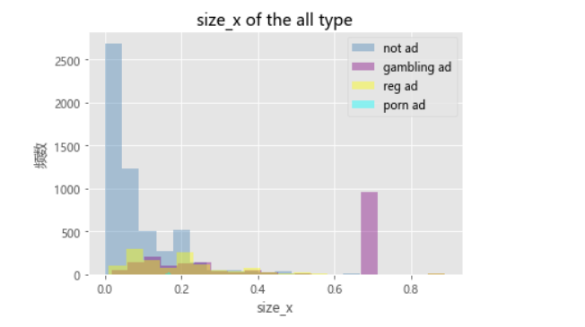
Background
Motivation
Methodology
Results
Allocation map
Histogram of the width distribution of the four types of images

Slide 37
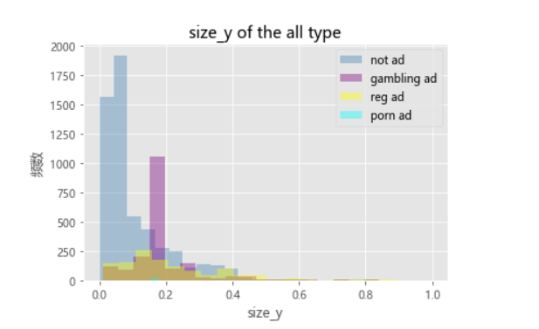
Background
Motivation
Methodology
Results
Allocation map
Histogram of the distribution of the lengths of the four types of images

Slide 38
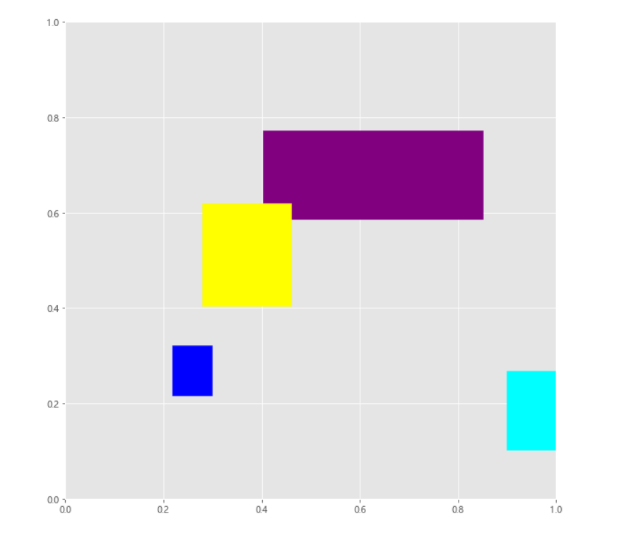
Background
Motivation
Methodology
Results
Allocation map
The average position of each type of image, expressed as a rectangle, in relation to the normalised web page:
Blue:non-advertising
yellow:regular advertisements
Purple:gambling advertisements
Cyan:pornographic advertisements

Slide 39
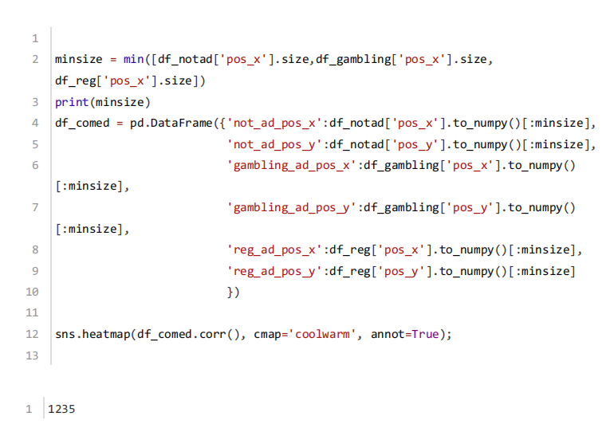
Background
Motivation
Methodology
Results
Correlation
Extract the position and size information from each type of image
check the covariance

Slide 40
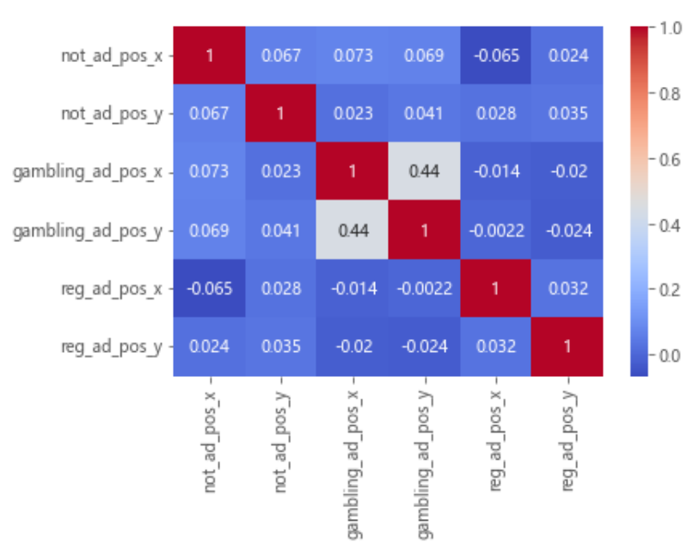
Background
Motivation
Methodology
Results
Correlation

Slide 41
Background
Motivation
Methodology
Results
Conclusion
non-advertising
Positioned centrally on the lower left
regular advertisements
Positioned mainly on the left, larger in size
gambling advertisements
positioned mainly above, large size, more spread out in x-direction
pornographic advertisements
Positioned mainly in the lower right
(The average position of each type of image)

Slide 42



Background
Motivation
Methodology
Results
Conclusion
The experimental data and results is more in line with the the most basic illustration of how we tend to consume the content on web pages

Slide 43

Background
Motivation
Methodology
Results
key takeaways
1
2
3
Left Is Right
Height Disadvantage
Hot Spots
the left side of your site will get much more attention than the right
the top of the page is often overlooked
more sites are starting to feature ads smack dab in the middle of their content

Slide 44
Background
Motivation
Methodology
Results
Discussion and Limitations
What are the limitations of this work？
It is difficult to collect URLs with specific pornographic game advertisements, most of the pages are still normal pages
it may be possible to make a pre-judgement in the future and decide whether to keep this page as one of the data sources

Slide 45


感谢观看
勤 学 / 修 德 / 明 辨 / 笃 实

